Slide 1
Car Damage Assessment Using Hybrid Classifier
Presented by – Mayank Singh

Slide 2
Abstract
The project puts forward an automatic approach towards detecting damage in a vehicle and also analysing the severity of the damage in order to make the process hassle free and quick
The approach makes use of convulational neural networks (CNN) and uses image processing techniques to analyse the damage
. A variety of different algorithms have been looked up to ensure greater accuracy

Slide 3
Introduction
In the fast pacing world today which is rapidly evolving in terms of technology and innovation transport is very imperative to the growth. However it is noted that more than 35000 vehicle accidents take place per annum. The large number of accidents then calls for an efficient insurance system, but unfortunately it is noted that the insurance policy holders have to wait for a considerably large amount of time in order to receive any rebursal related to their insured vehicle on the occurrence of an accident.
Moreover it is an often occurrence that the insurance personnel misses out on some of the hidden damages to the vehicle which is then not covered in the insurance appraisal. The process of analysis of damage is not very transparent and is in no way interactive with the client, which often leads to confusions and is not very effective either

Slide 4
Purpose
Aims at developing an automated system for the detection of damage
Aims to analyse the damage in a car due to multifarious reasons
cost effective and less time consuming innovation towards the analysis of vehicular damage

Slide 5
Since our previous meeting we divided our project into some stages which were supposed to be achieved before our 1st progress presentation. Those are-
Deciding the categories of our dataset
Collecting the dataset using web scraping
Studying different CNN models
Implementation of some models to check the accuracy

Slide 6
Data collection is defined as the procedure of collecting, measuring and analyzing accurate insights for research using standard validated techniques.In most cases, data collection is the primary and most important step for research, irrespective of the field of research. The approach of data collection is different for different fields of study, depending on the required information. The most critical objective of data collection is ensuring that information-rich and reliable data is collected for statisticalanalysis so that data-driven decisions can be made for research. Therefore, we have used web scrapping for collecting data set of images of damaged and non-damaged cars.
Data collection

Slide 7
WEB SCRAPING- Web scraping is a method for extracting data from websites.Web scraping software may access the World Wide Web directly using the Hypertext Transfer Protocol, or through a web browser.t is a form of copying, in which specific data is gathered and copied from the web, typically into a central local database or spreadsheet, for later retrieval or analysis.Web scraping a web page involves fetching it and extracting from it. Fetching is the downloading of a page (which a browser does when a user views a page). Therefore, web crawling is a main component of web scraping, to fetch pages for later processing. Once fetched, then extraction can take place.The content of a page may be parsed, searched, reformatted, its data copied into a spreadsheet, and so on. Therefore, we have used google selenium and import.io to extract or to collect data from google. With the help of web scrapping we have collected a dataset of more than 2500 images.

Slide 8
there are various models which we studied in this project such as – 1. VGGNET- VGGNET Has 2 model. Those are Vgg16 and vgg 19, both of these models differ in the number of layers. The important point to note here is that all the conv kernels are of size 3x3 and maxpool kernels are of size 2x2 with a stride of two. The idea behind having fixed size kernels is that all the variable size convolutional kernels used in Alexnet (11x11, 5x5, 3x3) can be replicated by making use of multiple 3x3 kernels as building blocks. The replication is in terms of the receptive field covered by the kernels This makes our model more deep hence much better for large dataset of image recognition. 2.RESNET- Resnet18 has around 11 million trainable parameters. It consists of CONV layers with filters of size 3x3 (just like VGGNet). Only two pooling layers are used throughout the network one at the beginning and the other at the end of the network
CNN MODELS-

Slide 9
3. INCEPTION- In an image classification task, the size of the salient feature can considerably vary within the image frame. Hence, deciding on a fixed kernel size is rather difficult. Lager kernels are preferred for more global features that are distributed over a large area of the image, on the other hand, smaller kernels provide good results in detecting area-specific features that are distributed across the image frame. For effective recognition of such a variable-sized feature, we need kernels of different sizes. That is what Inception does. Instead of simply going deeper in terms of the number of layers, it goes wider. Multiple kernels of different sizes are implemented within the same layer Inception v3 is a widely-used image recognition model that has been shown to attain greater than 78.1% accuracy on the ImageNet dataset. The model is the combination of many ideas developed by multiple researchers over the years

Slide 10
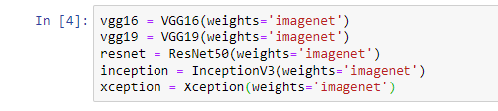
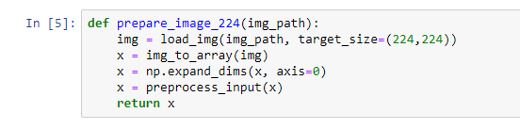
MODEL
In our model we have used above models to predict weather entered image is a car or not. These are pre-trained models with weight parameter as imagenet.
Imagenet is basically a large visual database designed for use in visual object recognition, like we are recognizing our entered image
It has more than 14 million images and categories accordingly

Slide 11
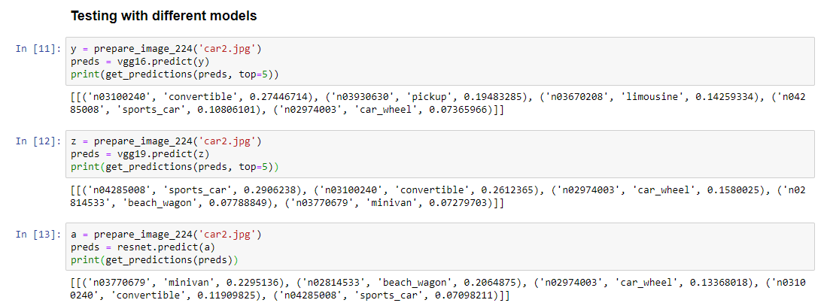
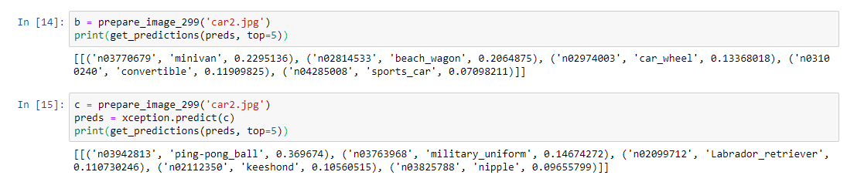

Slide 12
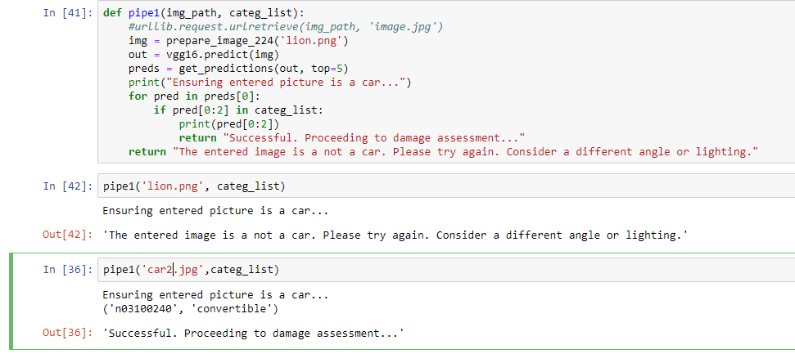
.

Slide 13
THANK YOU

